Slide 1


Unit 3: What’s So Bad About E-Cigarettes and Vape Pens?
© Stanford University

Slide 2

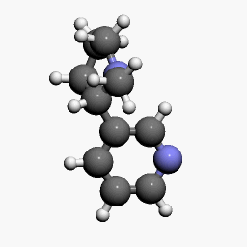


Effects of Nicotine

Slide 3
Nicotine Molecule
What is Nicotine?
Drug
Stimulant
Highly Addictive
Causes changes in brain chemistry
Found in tobacco products
If nicotine is unsafe, why do you think people still choose to use products that have nicotine?
Notes:
Teacher Talking Points:
Nicotine is a drug that is a stimulant, meaning it raises levels of physical or psychological activity in the body, and it is toxic at high doses.
It is highly addictive since it causes changes in brain chemistry quickly and leaves the brain craving more.
Nicotine is found in tobacco products and nicotine exposure during fetal development has lasting adverse consequences for brain development.
Data from studies of mice suggest that nicotine exposure during adolescence may have lasting adverse effects on brain development.
(click) If nicotine is unsafe, why do you think people still choose to use products that have nicotine?

Slide 4


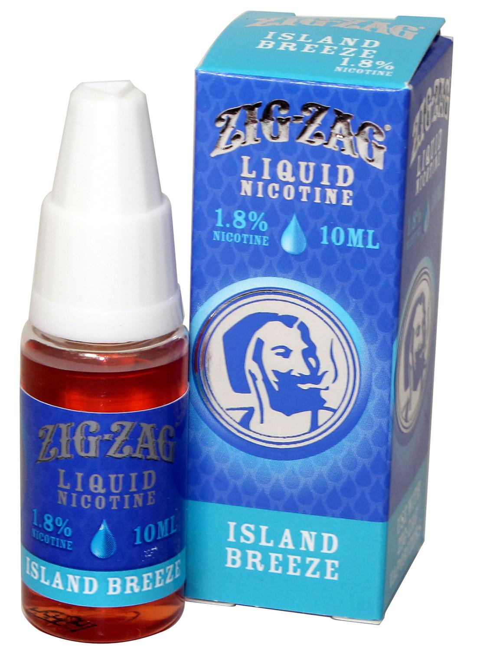


Where Can You Find Nicotine?
Notes:
Teacher Talking Points:
Let’s see where you can find this highly addictive drug.
(click) Nicotine can be found in tobacco and comes from tobacco leaves.
(click) Nicotine is found in cigarettes and tobacco companies made cigarettes more addictive by controlling and increasing nicotine levels and enhancing the impact of nicotine by adding chemicals
(click) Most hookah contains nicotine and overall, can have a lot of the same negative health effects of cigarettes
(click) E-juice used in e-cigs/vapes can contain varying levels of nicotine.

Slide 5
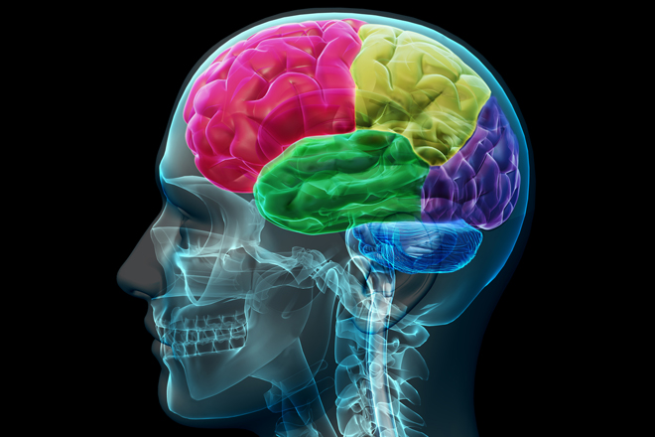
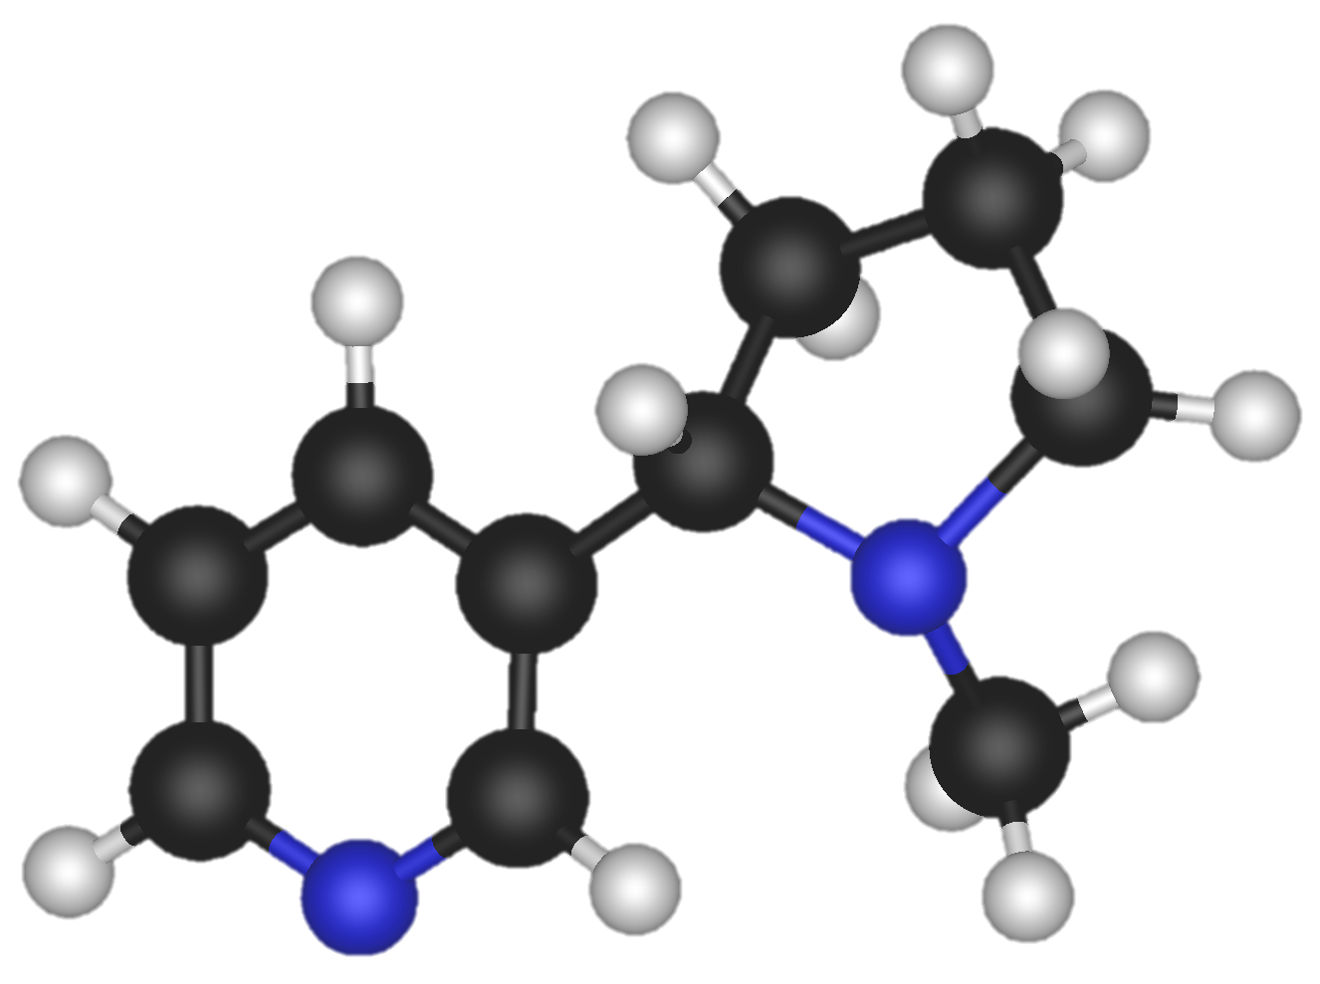
Nicotine in the Brain
Notes:
Teacher Talking Points:
The reaction that nicotine has in the brain results in the stimulation of pleasure centers in the brain
(click) When inhaled, nicotine enters into the brain after passing through the lungs
Then It binds to pleasure receptors in the brain
(click) That causes a release of pleasure chemicals such as dopamine, providing the user with a temporary feeling of pleasure

Slide 6
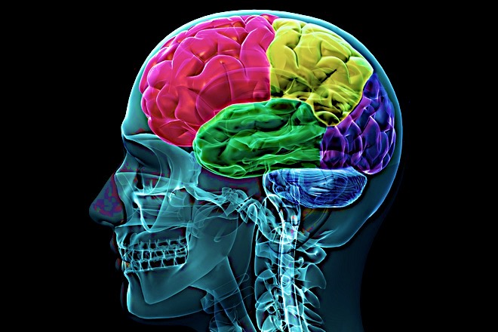
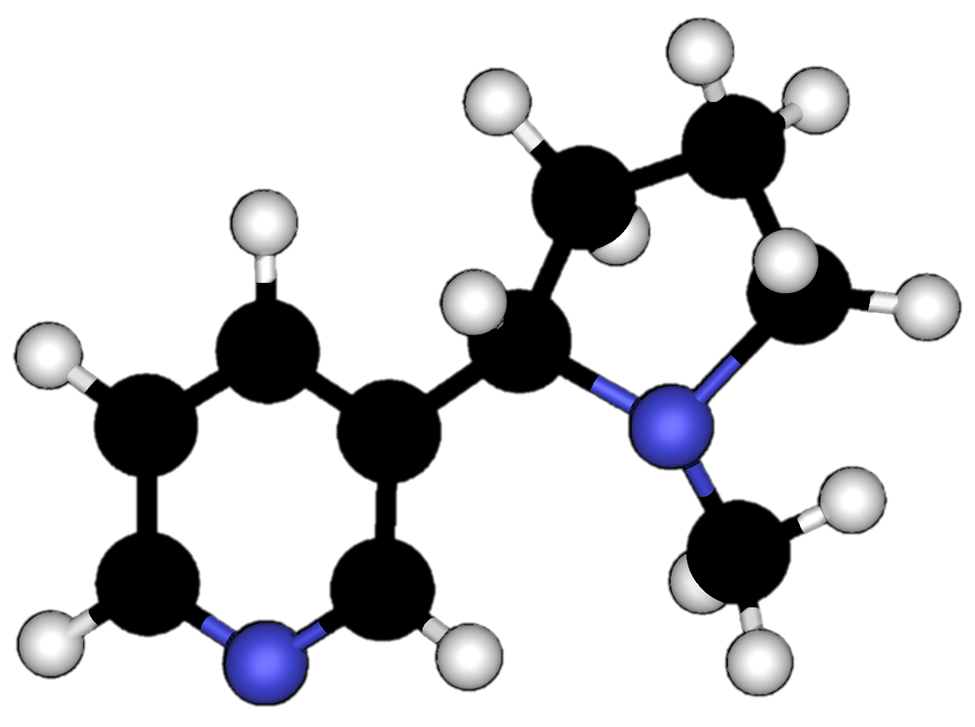
Nicotine Addiction
Notes:
Teacher Talking Points:
This might not sound dangerous but in reality, the nicotine interferes with the body’s natural ability to experience/communicate pleasure
Nicotine use creates floods of dopamine and intense feelings
The pleasure centers in the brain adapts to drug use by sensing the extra dopamine and then begins to produce less of it
,This means that the user has a hard time creating natural feelings of pleasure without nicotine
The user needs the nicotine just to feel normal.
Additionally, the pleasure centers in the brain creates a memory of nicotine and an appetite for it.
That appetite for nicotine, even despite it’s harmful consequences, is what we refer to as nicotine addiction

Slide 7

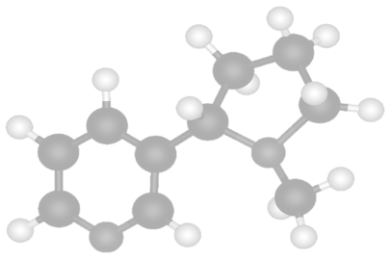
Cycle of Nicotine Addiction
Notes:
Teacher Talking Points:
Nicotine is highly addictive. What that means is, the human brain can develop such a strong dependence on the drug that the nicotine user can no longer control their desire or smoking behaviors.
(click) The cycle of nicotine addiction starts with bringing nicotine into the body. In this case it comes inhalation of cigarettes, hookah, and or e-cigs/vapes
(click) Nicotine enters the brain and activates the pleasure centers of the brain
(click) After, the level of nicotine in the body drops quickly
(click) This drop in nicotine levels causes the body to have a strong craving for nicotine that is satisfied by bringing more nicotine into the body
This cycle is powered by the body’s biological reaction to nicotine and isn’t controlled by the person vaping
Based on this information, what could you say to someone who says they won’t let themselves get addicted to nicotine?

Slide 8

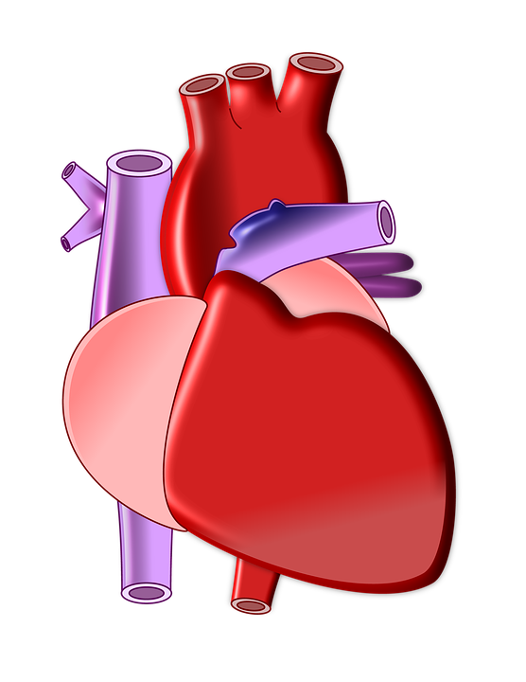
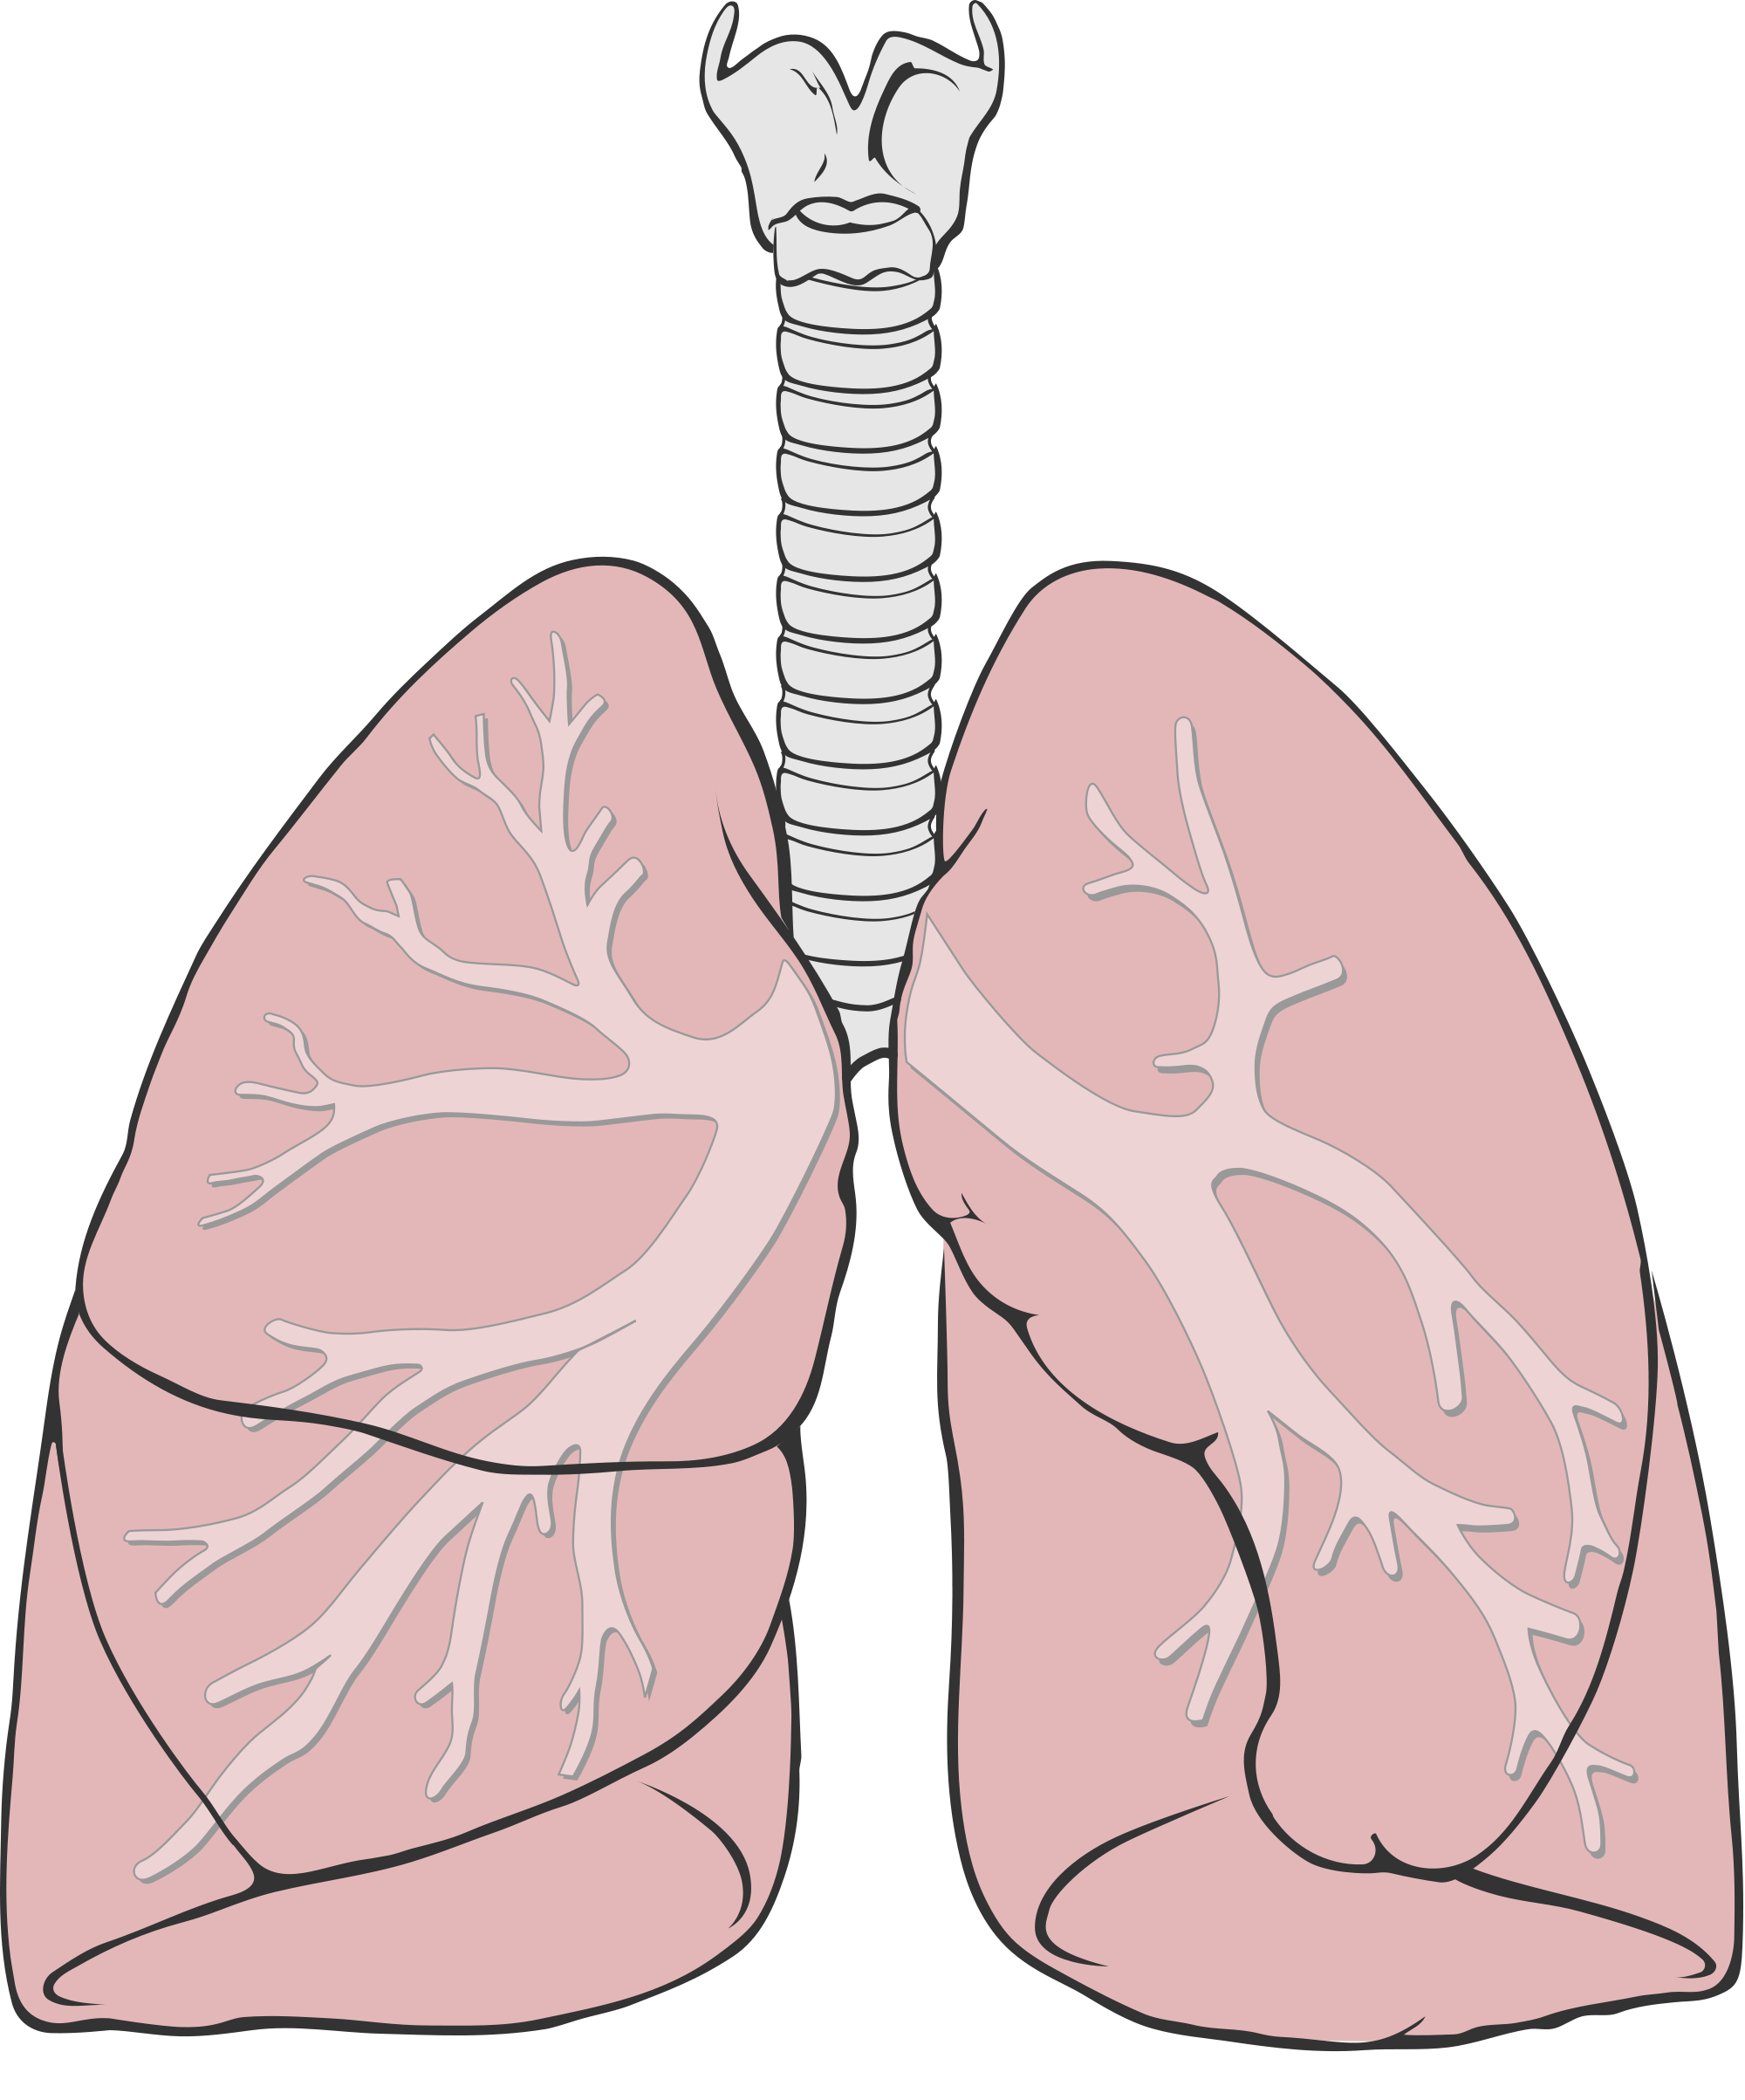
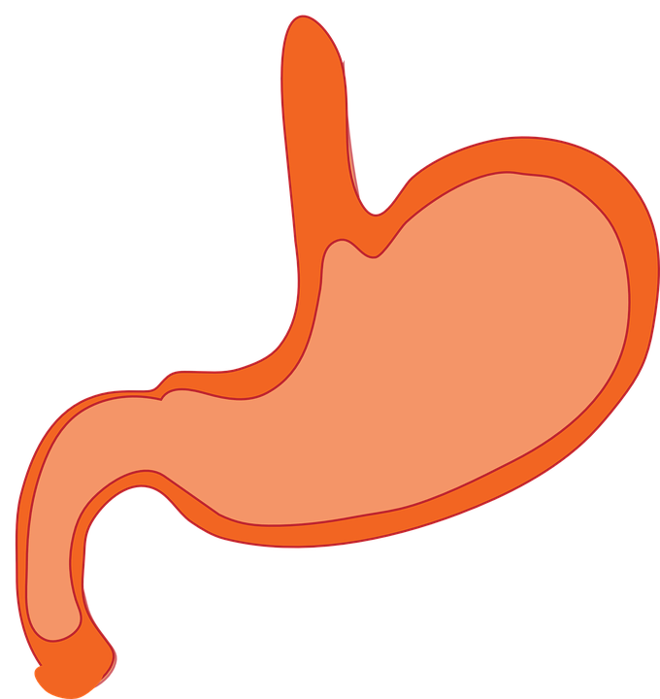
Nicotine and the Body
Notes:
Teacher Talking Points:
Nicotine doesn’t just have an effect on your brain it can also have effects all over your body
(Click) For example, using nicotine can also make your heart beat faster, because it can activate your “fight or flight response”
(Click) Nicotine can independently cause trouble breathing and damage to your lungs, outside of all the chemicals and toxins in cigarettes
(Click) Nicotine can cause you to have increased acid reflux
Also, it can cause insulin resistance, making it potentially more dangerous for those with diabetes
Nicotine can even negatively impact your reproductive organs

Slide 9

Effects of Flavorings

Slide 10












Flavors
Notes:
Teacher Talking Points:
(click) One of the major appeals of e-cigs/vapes is the over 7,000 flavors of e-liquid available.
The various trendy flavors have been a very successful marketing strategy that allows e-cig/vape users to consume nicotine without the harsh taste of cigarettes.
It may come as a surprise to many, but the flavors themselves pose a risk to the e-cig/vape user.
Some flavors have been shown to be toxic due to the chemicals they contain.

Slide 11


Cytotoxic Flavors
Cinnamon flavors may contain: Cinnamaldehyde, 2-Methoxycinnamaldehyde
Cherry flavors may contain: Benzaldehyde
Notes:
Teacher Talking Points:
Various cinnamon flavors contain cytotoxic compounds
The cherry flavor, benzaldehyde, has some toxicity

Slide 12
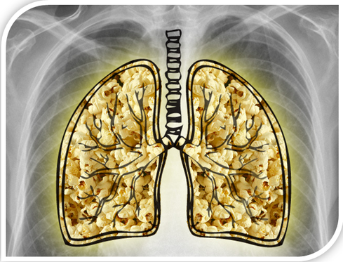
Popcorn Lung
Diacetyl
Alveoli & Bronchioles
Experience scarring
Image Credit: fileapopcornlunglawsuit.9k.com
Notes:
Teacher Talking Points:
Diacetyl and a closely related compound, 2,3-pentanedione, cause popcorn lung ( also know as constrictive bronchiolitis obliterans)
This irreversible respiratory disease was named after the factory workers inhaled artificial butter flavor while working, causing the small airways in the lungs become irreversibly scarred and constricted, impairing breathing.
Diacetyl has been found in many e-liquids with sweet flavors.

Slide 13


Effects on Health

Slide 14


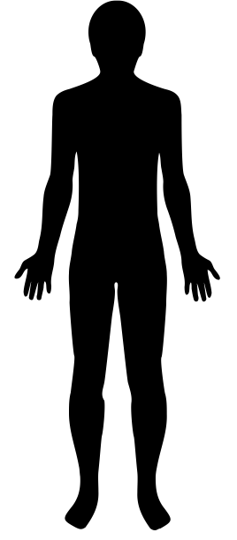
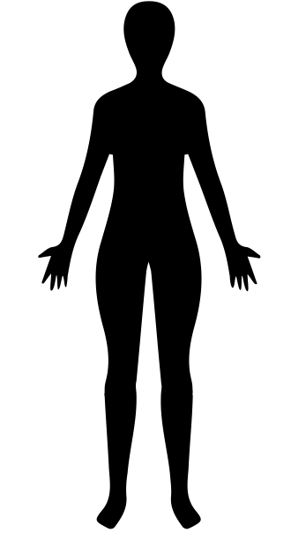


Health Risks to E-cig User
Notes:
Teacher Talking Points:
Based on current information, we know there are health risks when people use these product
(click) The aerosols produced by the chemicals in e-juice, enter into the user’s lungs and leave chemical residue behind
(click) Also, many e-cigs/vapes have nicotine, which is known to have effects on the cardiovascular system. Some recent studies show that acute use of e-cigarette impaired flow-mediated dilation, this suggests that e-cigarettes can lead to cardiovascular diseases
(click) Ear, Eye and Throat Irritation is common among e-cig/vape users
And perhaps most worrisome is the possibility of more young people developing an addiction to nicotine
(click) Nicotine use in early adolescence causes changes in the brain that make life-long addiction much more likely for young e-cig/vape users

Slide 15

Effects of E-Cigs
Notes:
Teacher Talking Points:
Since e-cig/vape products are so new and health professionals can’t fast forward into the future, all of the long-term consequences of these products are impossible to predict (click)
Based on what we do know today from research on the chemicals found in e-cig/vapes, we can say that these products are not harmless to the user or the people around them
For close to 20 years, health professionals did not know the long term effects of cigarette smoke either
Just imagine what else we will know in another 10 years we have a fuller picture of all of the health consequences

Slide 16


UNIT 3: Activity 4: : What is Thirdhand Smoke?
?
Notes:
Teacher Talking Points:
Another way that e-cigs pose a danger to people other than the smoker is through thirdhand smoke.

Slide 17
?
SHS
THS
Indoor Surfaces
Notes:
Teacher Talking Points:
(click) You may be familiar with the concept of secondhand smoke. How would you define secondhand smoke?
Secondhand smoke is smoke from burning tobacco products, such as cigarettes, cigars, or pipes and is toxic when inhaled
(click) Although it is not yet known whether secondhand aerosol from e-cig devices is harmful, there is evidence to show that thirdhand smoke is dangerous to others. Can you try and guess what “thirdhand smoke” is?
(click)Thirdhand smoke is chemicals in e-cig vapor/aerosol that remain on surfaces and in dust, even after the vaper and aerosol are gone

Slide 18





Thirdhand Smoke
Nicotine & other chemicals
Notes:
Teacher Talking Points:
(click)Thirdhand smoke is chemicals in e-cig vapor/aerosol that remain on surfaces and in dust, even after the vaper and aerosol are gone, and react with other chemicals in the environment to form toxic chemicals that are re-released into the environment
People and pets can be exposed to these potentially harmful chemicals through the respiratory system, through ingestions, and through skin exposure
Small children are especially at risk for thirdhand smoke exposure because they tend to touch surfaces and put their hands into their mouths and they have more vulnerable skin

Slide 19

Class Discussion
Knowing what we do about e-cigs, and considering all the things we don’t know about e-cigs why do teens choose to use e-cigs/vapes?
© Stanford University
Notes:
Facilitate a class discussion about this question. Remind students to be respectful. Correct any misinformation that students might express during the discussion.
Key Points to Consider:
Many teens wouldn’t use traditional cigarettes, why do they choose to use e-cigs/vapes?
How do you think traditional cigarette smokers felt when they learned about all the harmful health effects caused by cigarettes that were being covered up by tobacco companies?
How do you think an e-cig/vape user would feel if 10 years into the future they learned that e-cigs/vapes were just as harmful as traditional cigarettes?
How do you think advertising plays a role in a teen’s decision to use e-cigs/vapes?

